Slide 1
Costumer Churn Prediction and Analysis for ConnectTel
PRESENTATION BY
cHidera chukwukelu

Slide 2
INTRODUCTION
ConnectTel Telecom Company faces the pressing need to address customer churn, which poses a significant threat to its business sustainability and growth.
The company's current customer retention strategies lack precision and effectiveness, resulting in the loss of valuable customers to competitors.
Customer churn refers to the phenomenon where customers stop using a company's services over a given period. High churn rates pose a significant threat to business sustainability and growth as they result in loss of revenue and increased costs for acquiring new customers.

Slide 3
Objectives
By developing a robust customer churn prediction system using advanced analytics and machine learning techniques on available customer data,
ConnectTel can:
1. Accurately Forecast Customer Churn.
2. Implement Targeted Retention Initiatives.
3. Enhance Customer Loyalty.
4. Reduce Customer Attrition.
5. Maintain Competitive Edge, increased revenue, and improved overall business performance for ConnectTel.

Slide 4
Methodology
Data Preprocessing:
Data type preview
Checking for missing values in data
Feature Engineering
Label Encoding of Categorical features
Scaling Numerical features
Exploratory data Analysis of Numerical and Categorical Features:
Checking for outliers and patterns
Univariate, Bivariate and Multivariate analysis
Correlation exploration
Model building And Evaluation:
Feature Selection, Train and test set split
Logistics Regression, Random forest and linear SVC
Evaluation of best performing model metrics
Recommendations

Slide 5
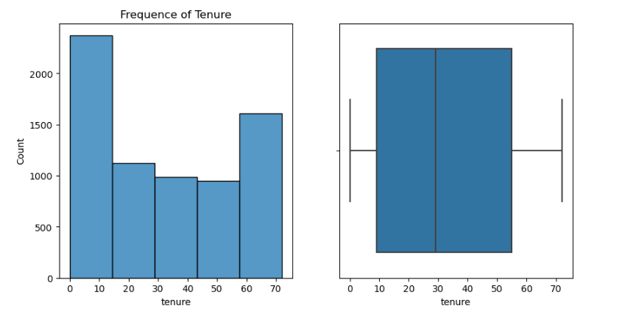
Univariate Analysis

Slide 6
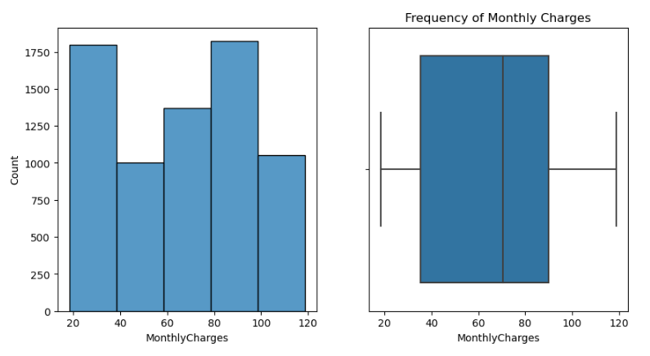
Univariate Analysis

Slide 7
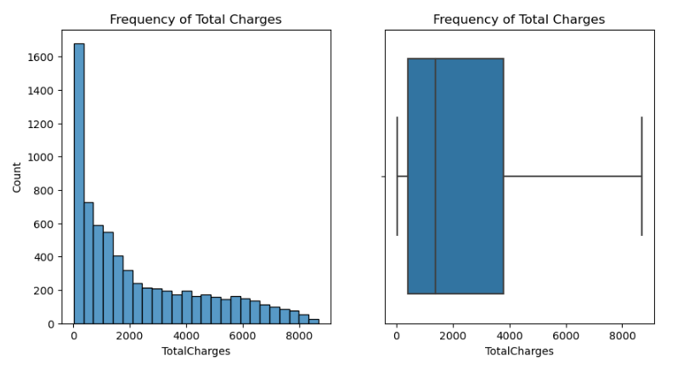
Univariate Analysis

Slide 8
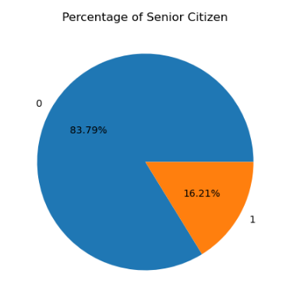
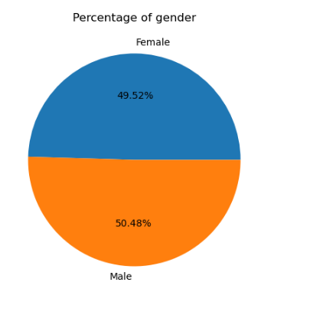
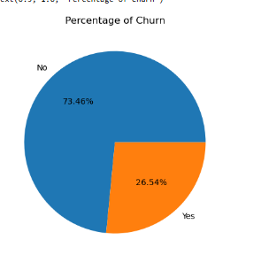
Univariate Analysis

Slide 9
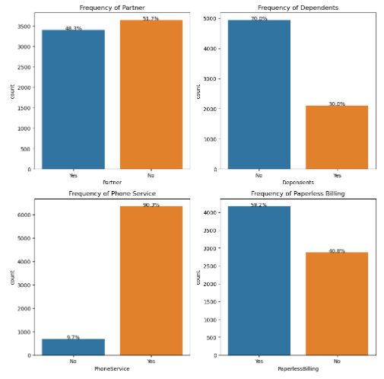
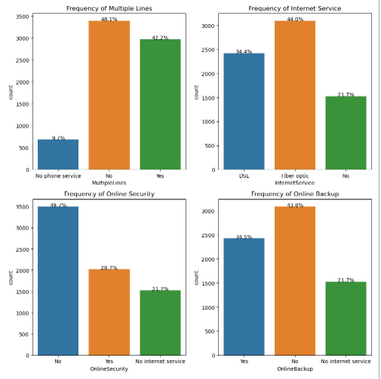
Univariate Analysis

Slide 10
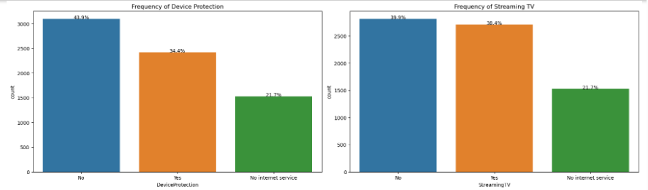
Univariate Analysis

Slide 11
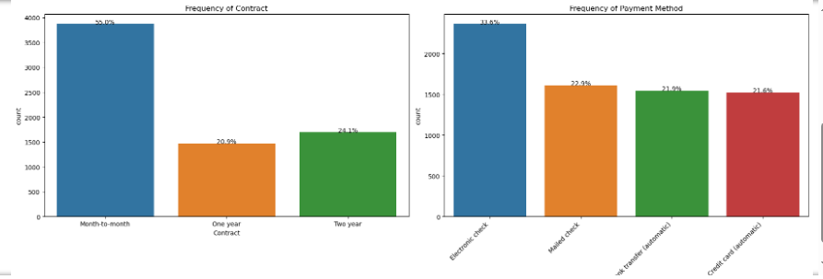
Univariate Analysis

Slide 12
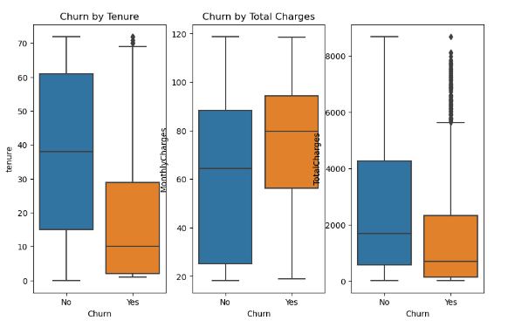
Bivariate Analysis

Slide 13
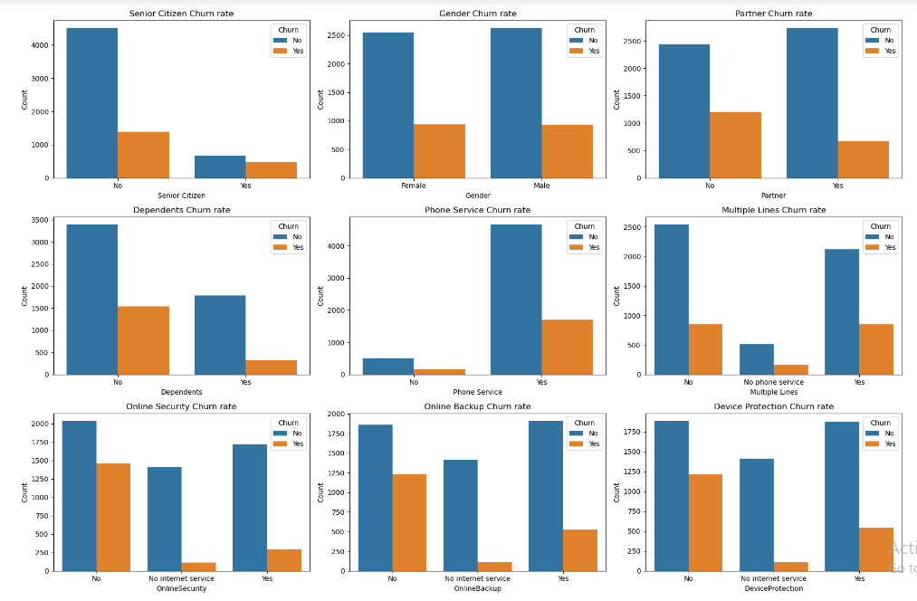
Bivariate Analysis

Slide 14
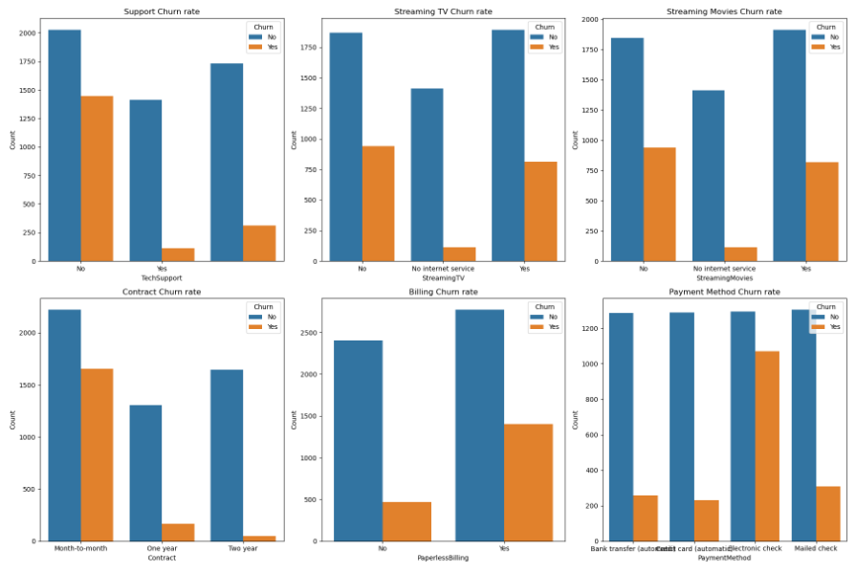
Bivariate Analysis

Slide 15
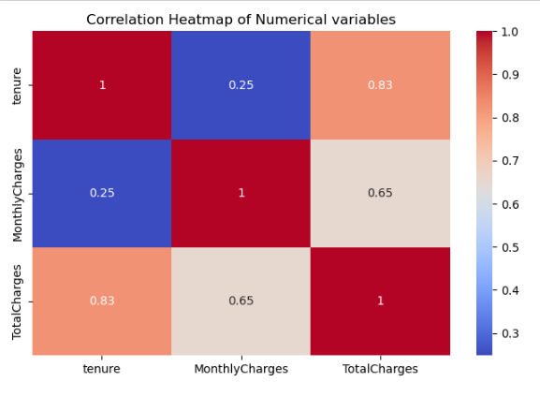
Multivariate Analysis

Slide 16
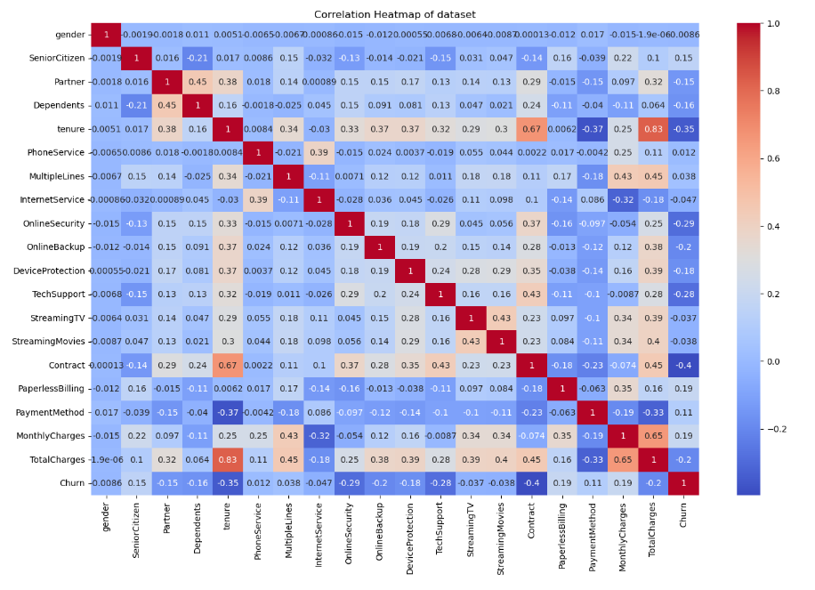
Multivariate Analysis

Slide 17
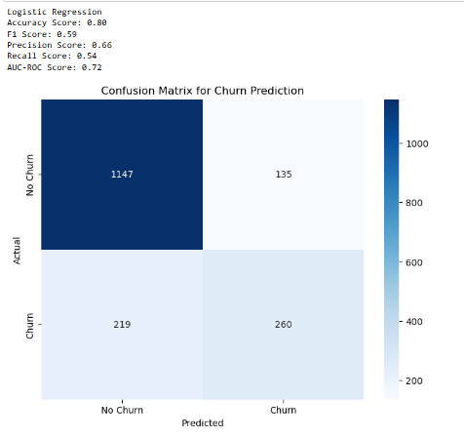
Model Evaluation Results
Accuracy (0.80): 80% of all predictions are correct.
F1 Score (0.59): Balanced measure of precision and recall, moderate performance.
Precision (0.66): 66% of predicted churners actually churn.
Recall (0.54): The model correctly identifies 54% of actual churners.
AUC-ROC (0.72): The model's ability to distinguish between churners and non-churners is fair.

Slide 18
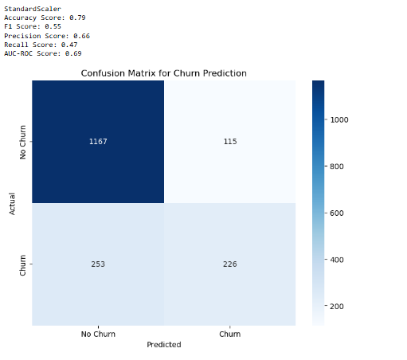
Model Evaluation Results
Accuracy (0.79): 80% of all predictions are correct.
F1 Score (0.55): Balanced measure of precision and recall, moderate performance.
Precision (0.66): 66% of predicted churners actually churn.
Recall (0.47): The model correctly identifies 54% of actual churners.
AUC-ROC (0.69): The model's ability to distinguish between churners and non-churners is fair.

Slide 19
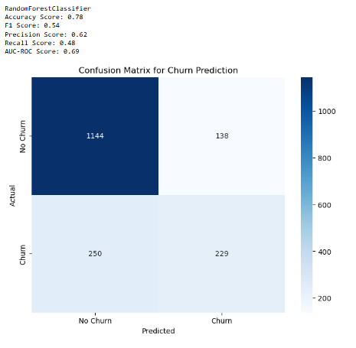
Model Evaluation Results
Accuracy (0.78): 78% of all predictions are correct.
F1 Score (0.54): Balanced measure of precision and recall, moderate performance.
Precision (0.62): 62% of predicted churners actually churn.
Recall (0.48): The model correctly identifies 48% of actual churners.
AUC-ROC (0.69): The model's ability to distinguish between churners and non-churners is fair.

Slide 20
Recommendations for Model Improvement
Improve Recall: Focus on reducing false negatives to catch more actual churners.
Feature Importance: Analyze which features are most important in the Random Forest model and consider focusing on or engineering new features based on these insights.
Hyperparameter Tuning: Optimize the Random Forest parameters (e.g., number of trees, max depth) to improve performance.
Ensemble Methods: Consider combining this model with others (like the logistic regression) for potentially better results.
Address Class Imbalance: Use techniques like class weighting or sampling methods to handle the imbalanced dataset.

Slide 21
Recommendations to ConnectTel
Develop special programs to engage and retain customers during their early tenure to increase long-term loyalty.
Develop and market attractive streaming packages to increase adoption of these services.
Promote add-on services like online security, backup, and device protection as they seem to improve customer retention.
Create family or couple plans to encourage customer retention among those with partners. For single customers, focus on value-added services that appeal to individual users.
Focus on expanding internet access to the remaining unserved population, potentially through targeted outreach or infrastructure investments.

